Slide 1


Ventilator Pressure Prediction
Lucile Rabeau

Slide 2



A few numbers.
Chronic respiratory diseases

Slide 3
A few numbers.
Chronic respiratory diseases
Asthma
Allergies
Cancer
Mucoviscidose
BPCO
…

Slide 4
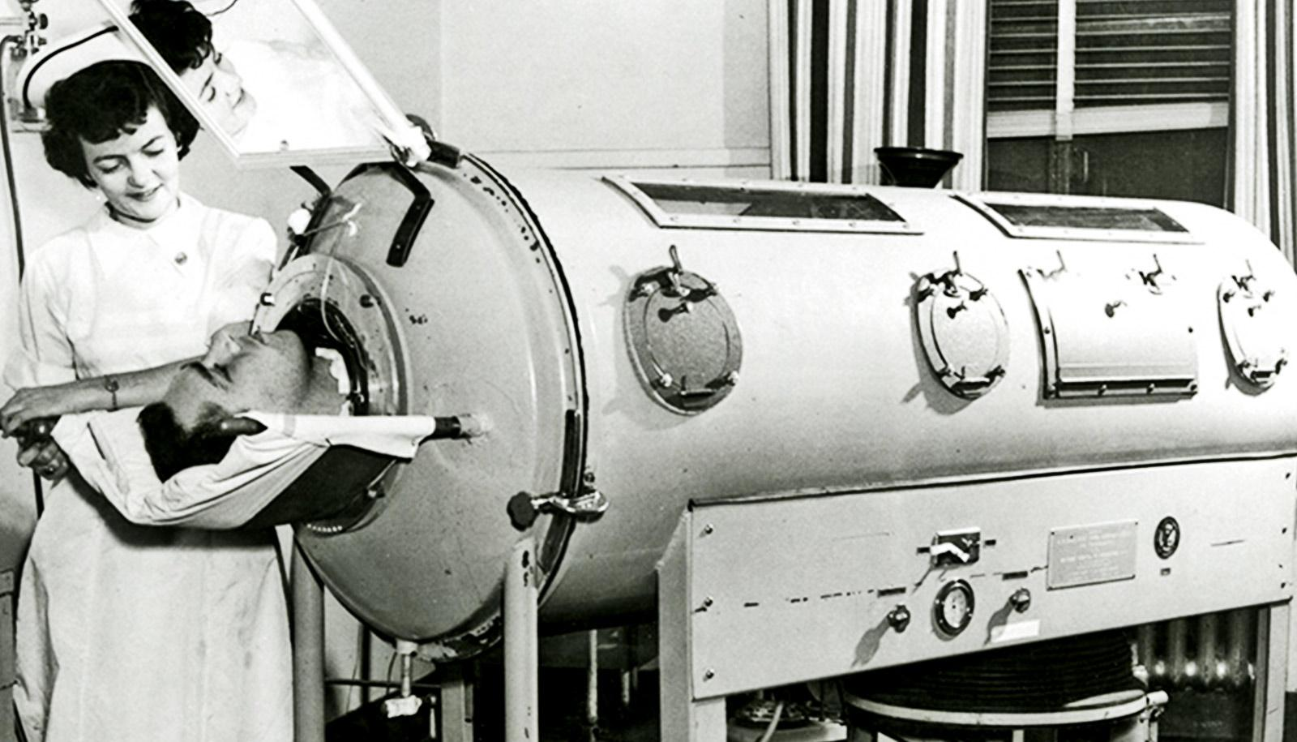
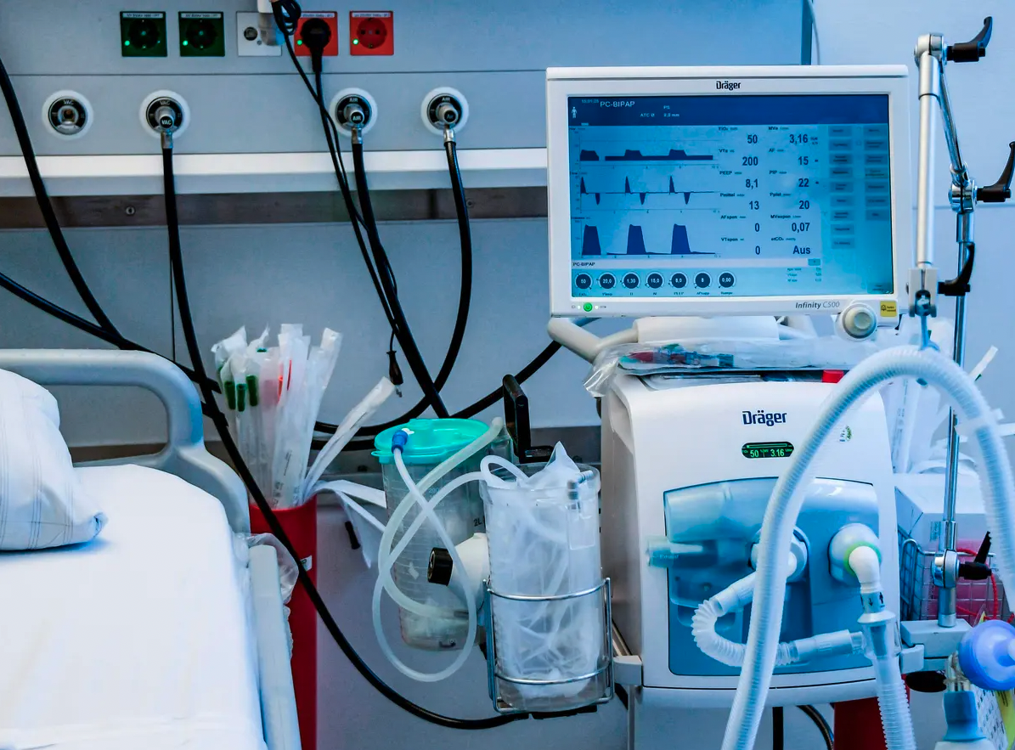
Ventilators.
Polio, 1931
COVID-19, 2020

Slide 5
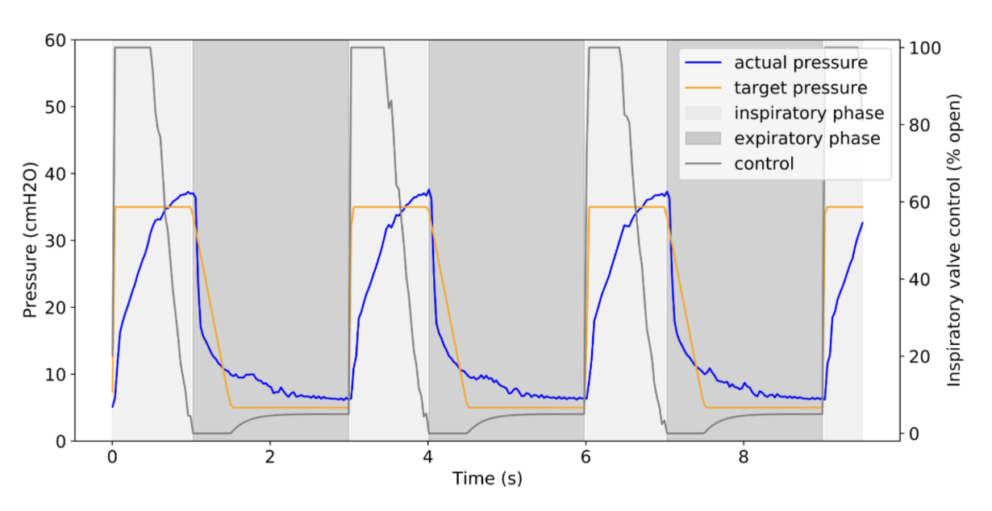
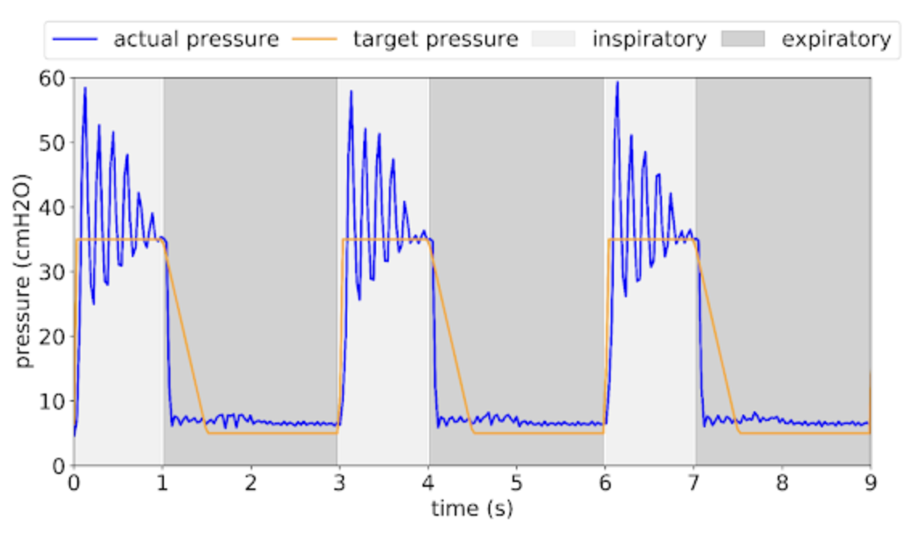
Current methods.
Clinician-prescribed breathing waveform
Current method
Suo et al., 2021
Time consuming for doctors and medical staff
Not adaptable to specific patients

Slide 6
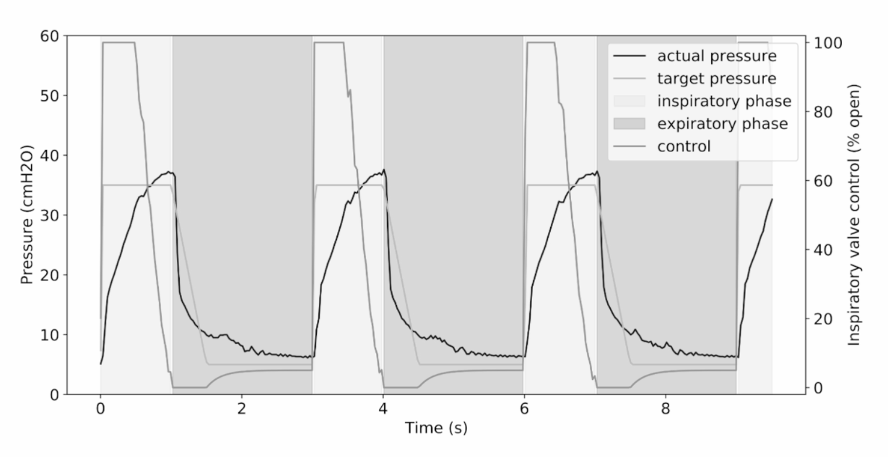
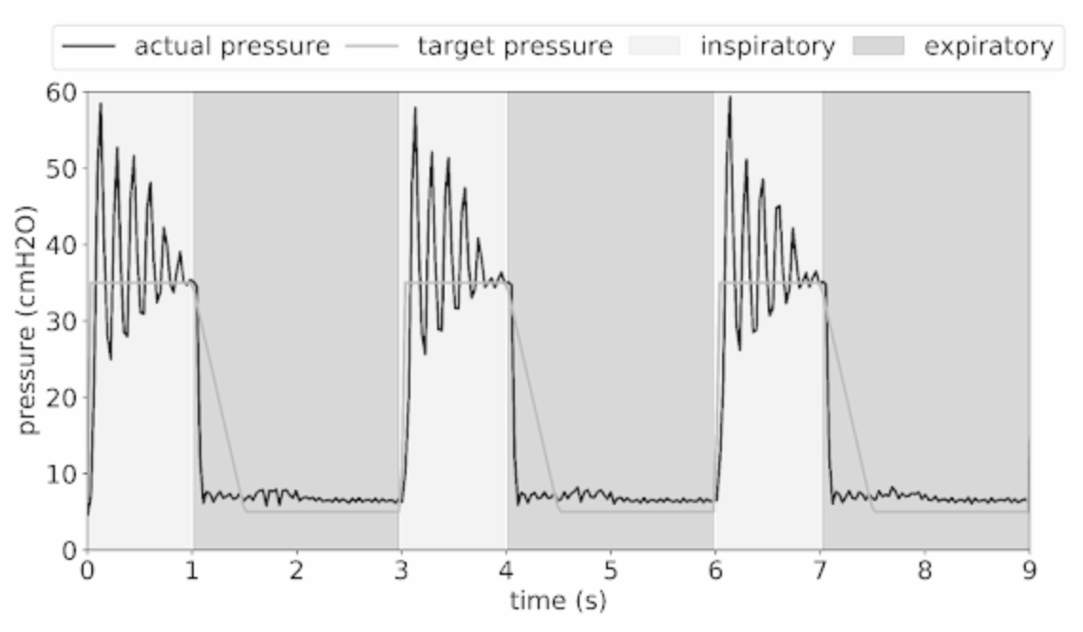
Current methods.
Clinician-prescribed breathing waveform
Current method
Objective: Predict the “best” pressure
Suo et al., 2021
Time consuming for doctors and medical staff
Not adaptable to specific patients

Slide 7
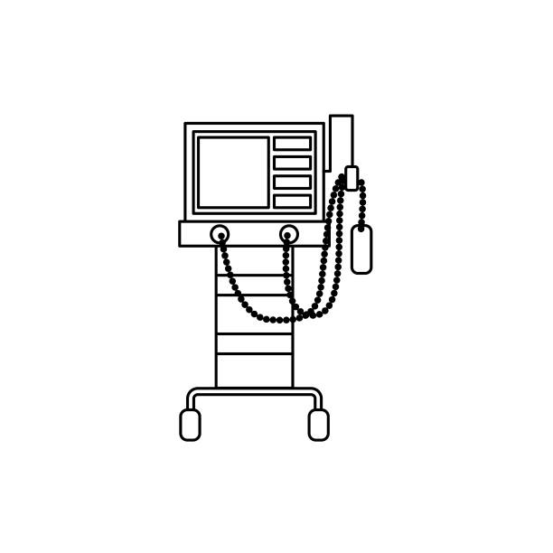
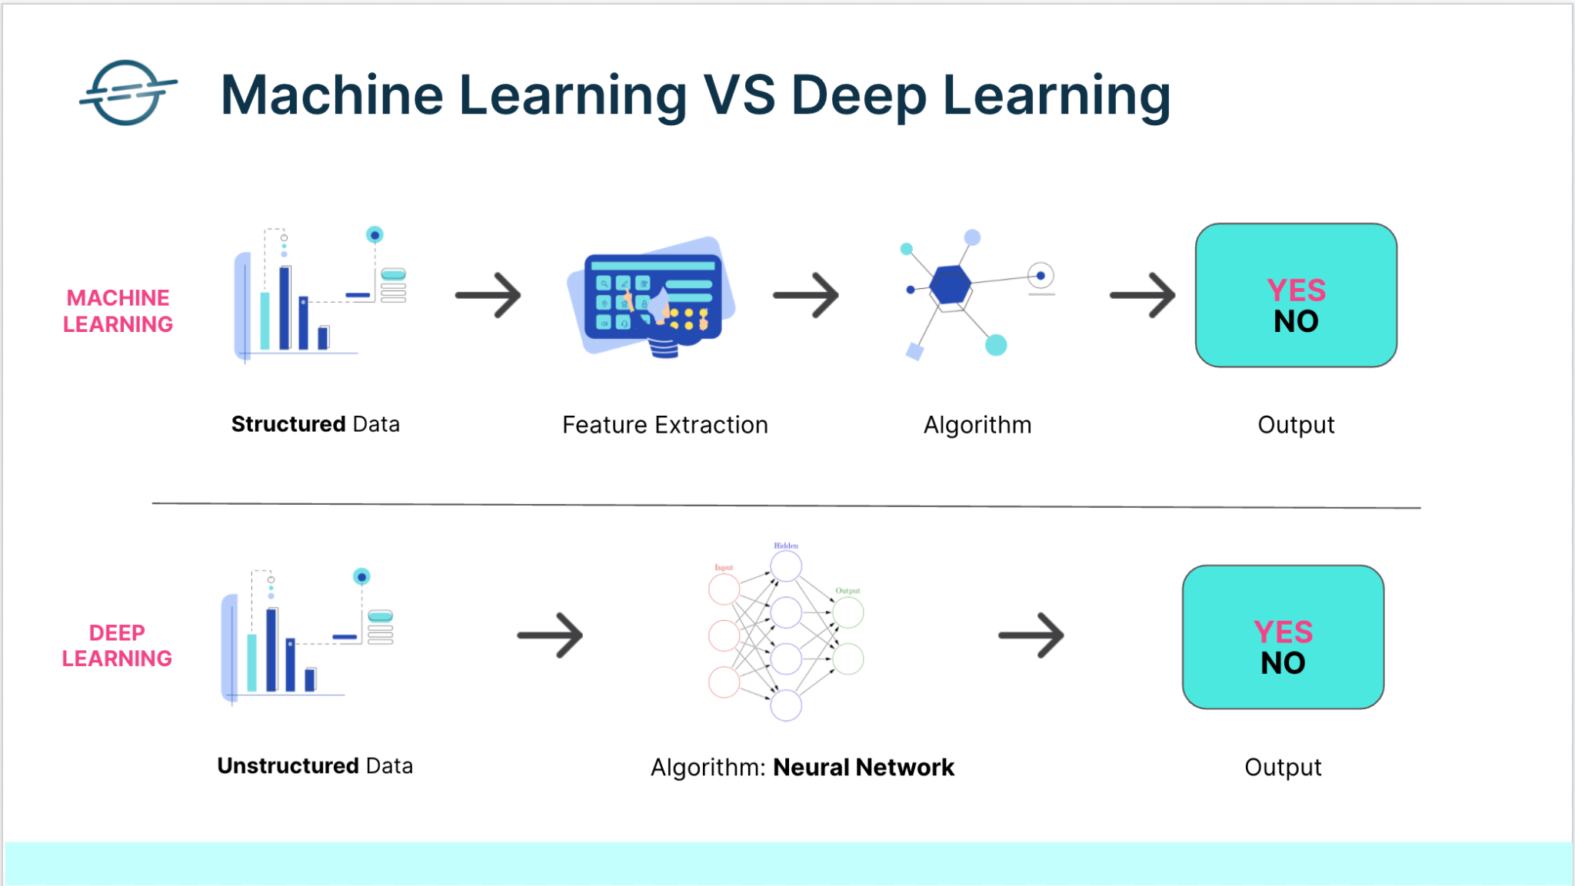
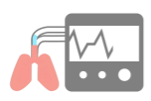
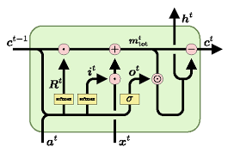








How to.
Lung simulation
Preprocessing
Deep Learning
Prediction
Breathing

Slide 8

Application.
Just Breathe

Slide 9
Conclusions & perspectives.
Clinician-prescribed breathing waveform
Current method
Suo et al., 2021

Slide 10
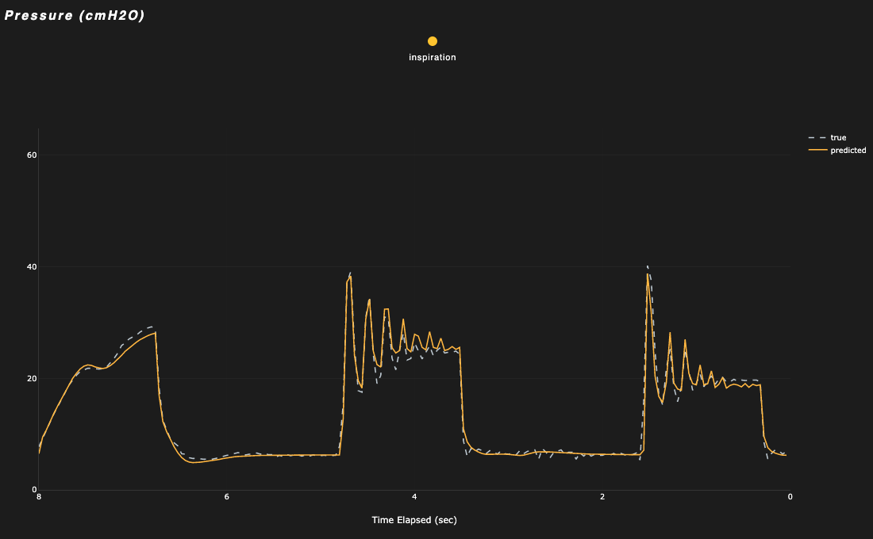
Conclusions & perspectives.
Clinician-prescribed breathing waveform
Current method
Suo et al., 2021

Slide 11


Conclusions & perspectives.
Interstellar, 2014

Slide 12
Thank you.
‹#›

Slide 13
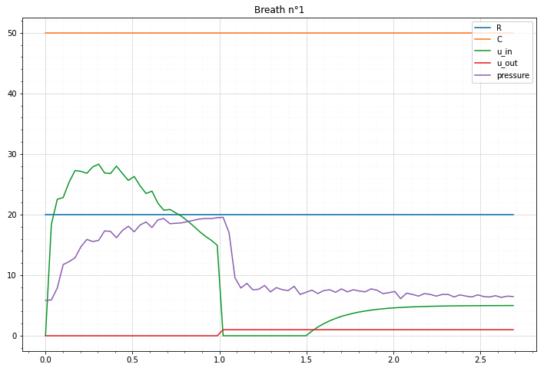
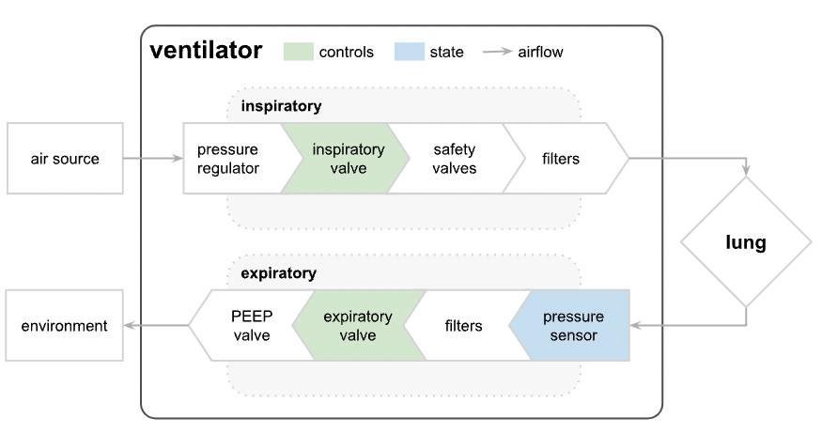
Source data.
Artificial test lung connected to a modified ventilator (Google AI Princeton lab)
inspiration
expiration
Suo et al., 2021
Time (sec)

